Slide 1
Job Order Cost System
Accounting Principles
7th Edition
Weygandt • Kieso • Kimmel
Chapter 21
Prepared by Naomi Karolinski
Monroe Community College
and
Marianne Bradford
Bryant College

Slide 2

CHAPTER 21
JOB ORDER COST ACCOUNTING
After studying this chapter, you should be able to:
1 Explain the characteristics and purposes of cost accounting.
2 Describe flow of costs in a job order cost accounting system.
3 Explain the nature and importance of a job cost sheet.

Slide 3
CHAPTER 21
JOB ORDER COST ACCOUNTING
After studying this chapter, you should be able to:
4 Indicate how the predetermined overhead rate is determined and used.
5 Prepare entries for jobs completed and sold.
6 Distinguish between under- and overapplied manufacturing overhead.

Slide 4
COST ACCOUNTING SYSTEMS
STUDY OBJECTIVE 1
Cost accounting
  The measuring, recording, and reporting of product costs.
Both the total cost and the unit cost of each product is determined from the accumulated data.
A cost accounting system consists of accounts for the various manufacturing costs. These accounts are fully integrated into the general ledger of a company.
Notes:
3

Slide 5
COST ACCOUNTING SYSTEMS
An important feature of a cost accounting system is the use of a perpetual inventory system. Such a system provides immediate, up-to-date information on the cost of a product.
There are 2 basic types of cost accounting systems:
1) a job order cost system
2) a process cost system
Notes:
3

Slide 6
COST ACCOUNTING SYSTEMS
Under a job order cost system, costs are assigned to each job.
An example of a job would be the manufacture of a high-speed drilling machine.
An example of a batch would be the printing of 225 wedding invitations.
The objective is to calculate the cost per job.

Slide 7
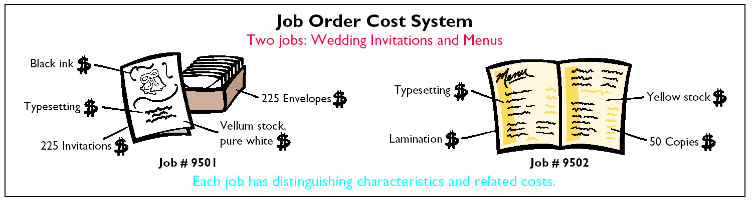
Job Order Cost System
Notes:
4

Slide 8
COST ACCOUNTING SYSTEMS
Process costing accounts for and accumulates product-related costs for a period of time.
A process cost system is used when a series of connected manufacturing processes or departments produce a large volume of similar products.

Slide 9
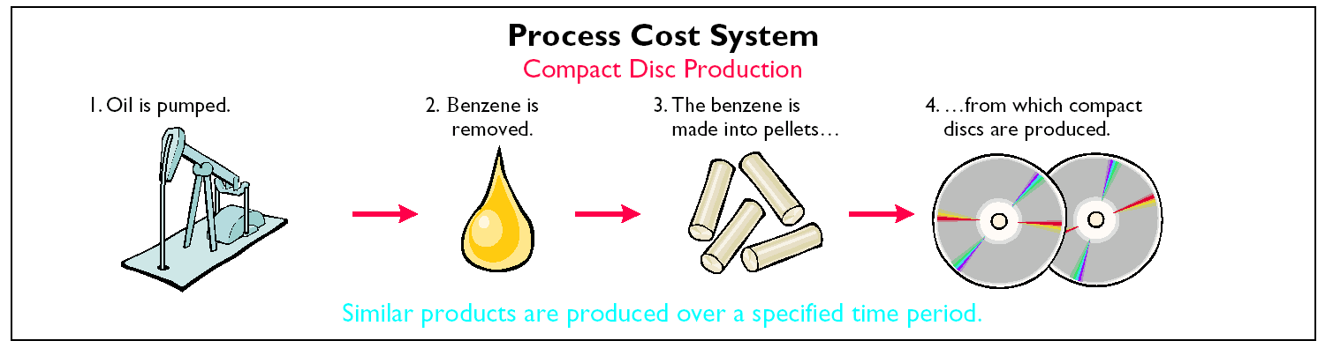
PROCESS COST SYSTEMS
Notes:
5

Slide 10
Cost accounting involves the measuring, recording, and reporting of:
a. product costs.
b. future costs.
c. manufacturing processes.
d. managerial accounting decisions.
Chapter 21

Slide 11
Cost accounting involves the measuring, recording, and reporting of:
a. product costs.
b. future costs.
c. manufacturing processes.
d. managerial accounting decisions.
Chapter 21

Slide 12
JOB ORDER COST FLOW
STUDY OBJECTIVE 2
The flow of costs in job order cost accounting parallels the physical flow of the materials as they are converted into finished goods.
There are 2 major steps in the flow of costs:
1) accumulating the manufacturing costs incurred
2) assigning the accumulated costs to the work done
Notes:
6

Slide 13
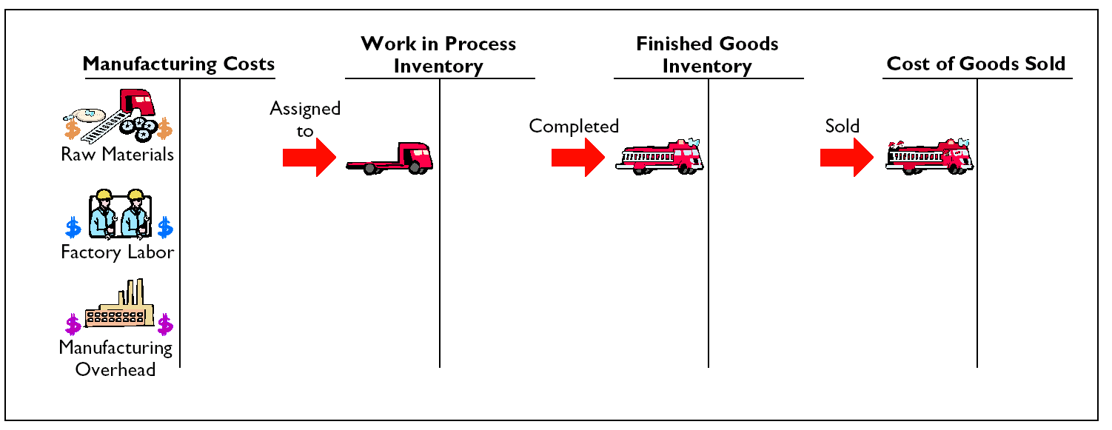
FLOW OF COSTS IN JOB ORDER COST ACCOUNTING

Slide 14
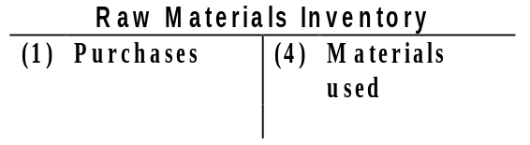
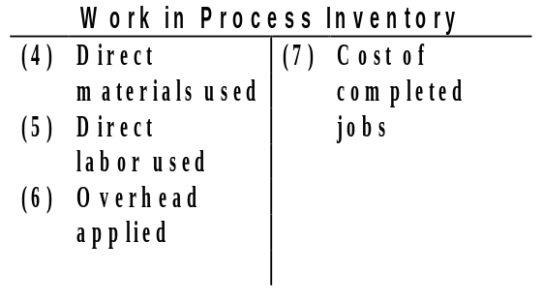
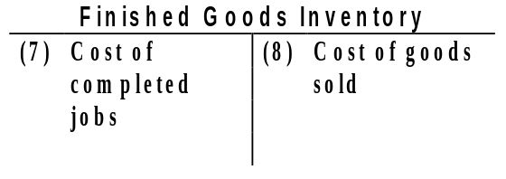
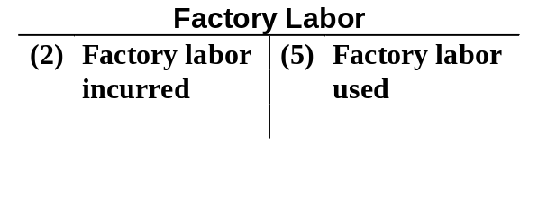
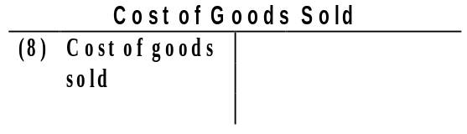
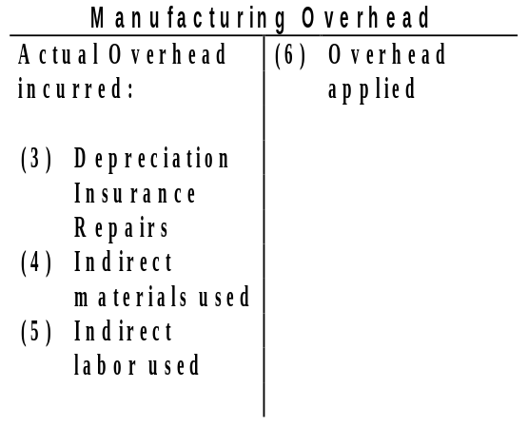
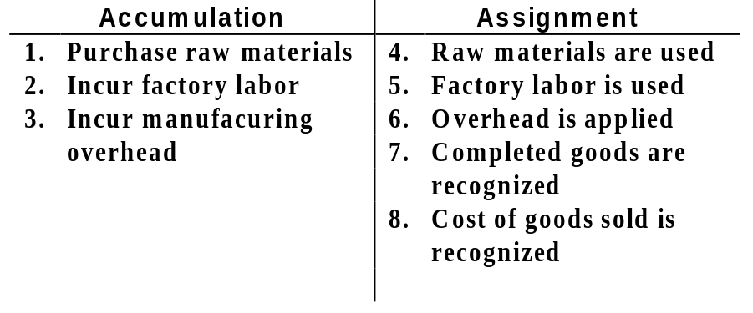
JOB ORDER
COST ACCOUNTING SYSTEM
Job Order Cost Accounting
4
7
8
5
Key to Entries:
6
Notes:
7

Slide 15
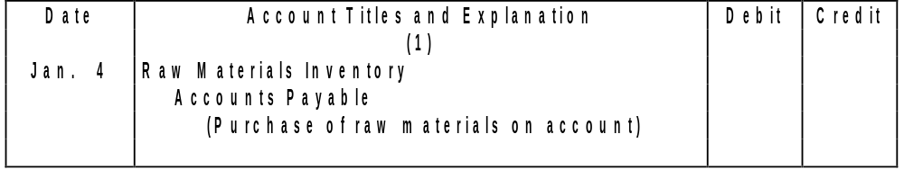
JOB ORDER COST FLOW
In a job order cost system, manufacturing costs are recorded in the period in which they are incurred.
The costs of raw materials purchased are debited to Raw Materials Inventory when the materials are received.
No effort is made at this point to associate the cost of materials with specific jobs or orders.
On January 4, Wallace Products Inc. purchases 2,000 handles at $5 per unit ($10,000) and 800 modules at $40 per unit ($32,000) for a total cost of $42,000.
42,000
42,000

Slide 16
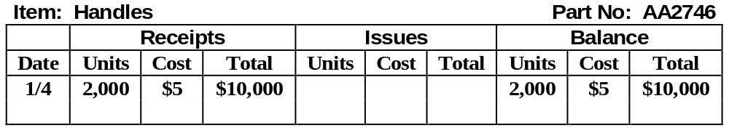
MATERIALS INVENTORY CARD
Raw Materials Inventory is a control account. The subsidiary ledger consists of individual records – in the form of:
1) mechanically or manually prepared accounts or cards or
2) data files maintained electronically on disks or magnetic tape
The card for Stock No. AA2746 following the purchase is shown below.

Slide 17
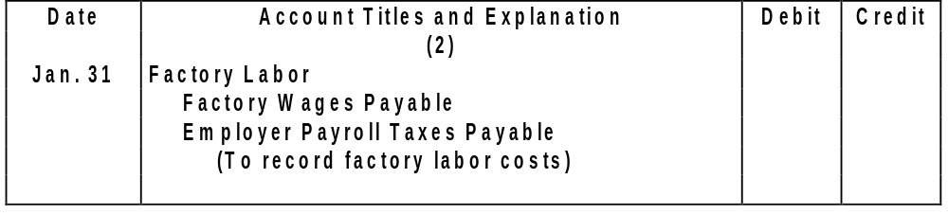
JOB ORDER COST FLOW
In a manufacturing company, the cost of factory labor consists of
1) gross earnings of factory workers
2) employer payroll taxes on such earnings
3) fringe benefits incurred by the employer
Labor costs are debited to Factory Labor when they are incurred.
Wallace Products incurs $32,000 of factory labor costs, of which $27,000 relates to wages payable and $5,000 relates to payroll taxes payable in January. The entry is:
32,000
27,000
5,000
Notes:
9

Slide 18
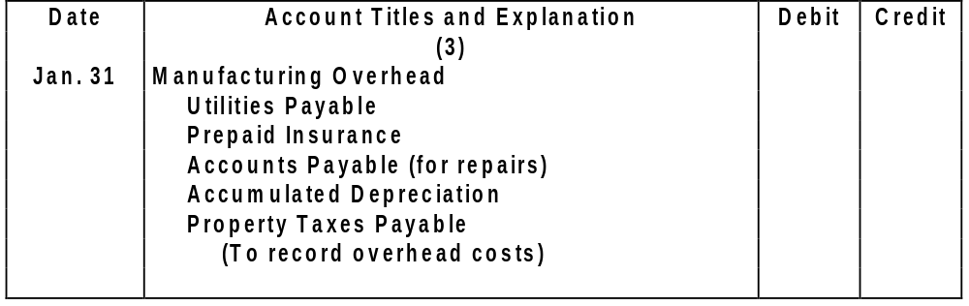
JOB ORDER COST FLOW
Overhead costs may be recognized daily, as in the case of machinery repairs and the use of indirect materials and indirect labor.
Overhead costs may also be recorded periodically through adjusting entries. Property taxes, depreciation, and insurance are recorded periodically.
A summary entry for January overhead for Wallace Products Company is:
13,800
4,800
2,000
2,600
3,000
1,400
Notes:
17

Slide 19
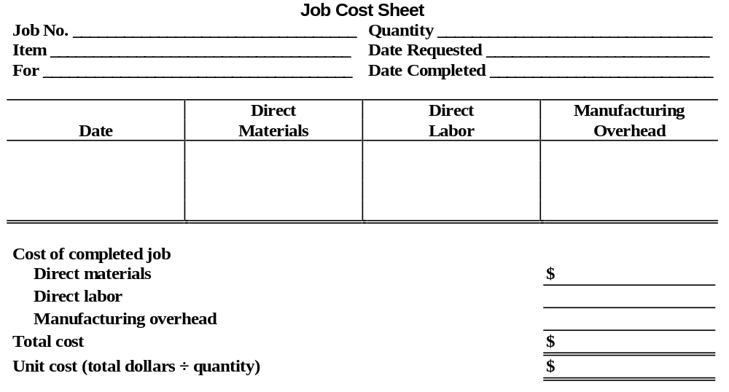
JOB COST SHEET
STUDY OBJECTIVE 3
A job cost sheet is a form used to record the costs chargeable to a specific job and to determine the total and unit cost of the completed job. Postings to job cost sheets are made daily.

Slide 20
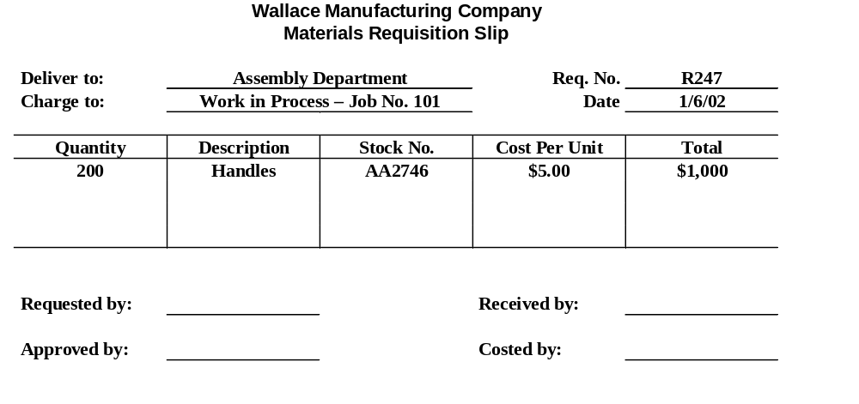
MATERIALS REQUISITION SLIP
The authorization for issuing raw materials is made on a prenumbered materials requisition slip. As shown below, the requisition should indicate whether (1) the quantity and type of materials (direct or indirect) withdrawn and (2) the amount to be charged.

Slide 21
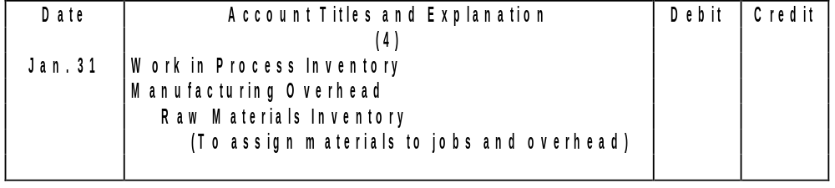
JOB ORDER COST FLOW
The requisition is prepared in duplicate. A copy is retained in the storeroom as evidence of the materials released; the original is sent to accounting, where the cost per unit and total cost of the materials used are determined.
If $24,000 of direct materials and $6,000 of indirect materials are used in Wallace Products in January, the entry is as shown below.
24,000
6,000
30,000
Notes:
27

Slide 22
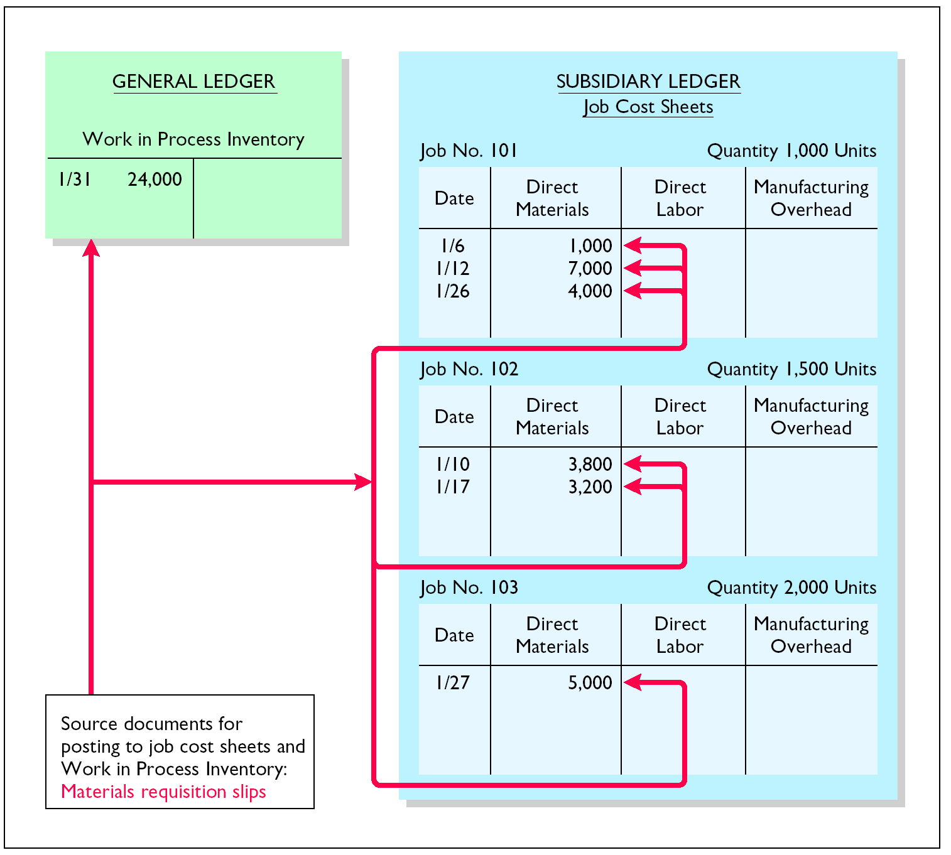
JOB COST SHEETS- DIRECT MATERIALS
The requisition slips show total direct materials costs of $12,000 for Job No. 101, $7,000 for Job No. 102, and $5,000 for Job No. 103. The posting of requisition slip R247 and other postings to the job cost sheets are shown in this illustration.
Notes:
Fix me

Slide 23
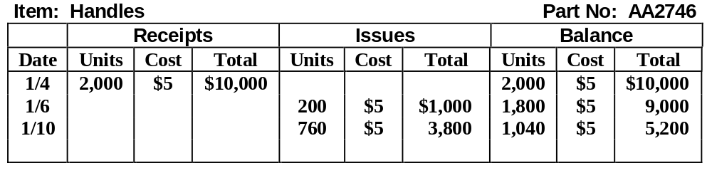
MATERIALS INVENTORY CARD FOLLOWING ISSUANCES
The materials inventory record for Part No. AA2746, shows the posting of requisition slip R247 and an assumed requisition slip for 760 handles costing $3,800 on January 10 for Job 102, is shown below.

Slide 24
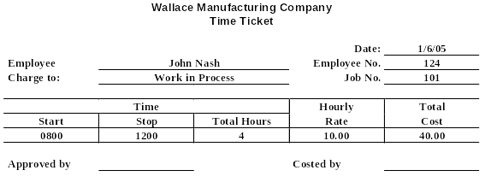
TIME TICKET
Factory labor costs are assigned to jobs on the basis of time tickets prepared when the work is performed. The time ticket should indicate the employee, the hours worked, the account and job to be charged, and the total labor cost. Work in Process Inventory is debited for direct labor and Manufacturing Overhead is debited for indirect labor.
Bob Kadler
M.Cher

Slide 25
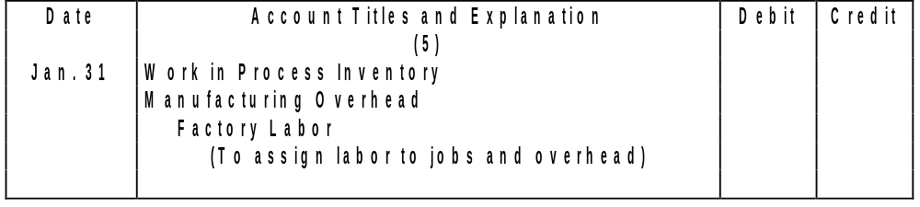
JOB ORDER COST FLOW
If the $32,000 total factory labor cost incurred in January consists of $28,000 of direct labor and $4,000 of indirect labor, the entry is as shown below.
28,000
4,000
32,000

Slide 26
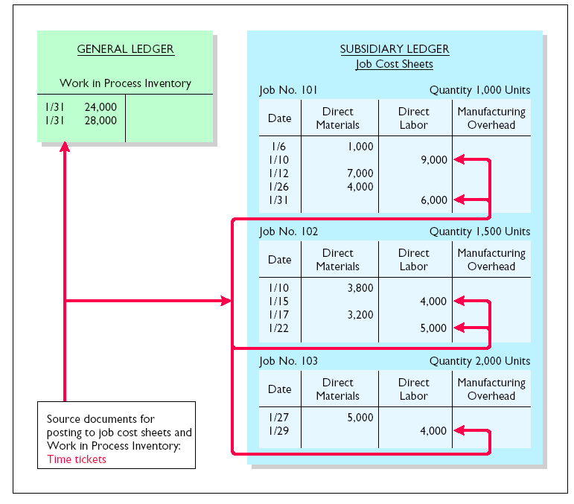
JOB COST SHEETS - DIRECT LABOR
The labor costs chargeable to the three jobs are $15,000, $9,000, and $4,000. The postings to the direct labor columns of the job cost sheets should equal the posting of direct labor to Work in Process Inventory.
Notes:
12

Slide 27
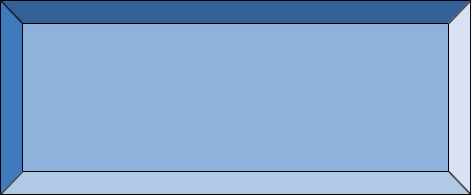

FORMULA FOR PREDETERMINED OVERHEAD RATE
Study Objective 4
Manufacturing overhead is estimated and assigned to work in process and to specific jobs on an estimated bases through a predetermined overhead rate.
This rate is established by the beginning of the year and is based on the relationship between estimated annual overhead costs and expected annual operating activity.
This relationship is expressed in terms of a common activity base such as direct labor costs, direct labor hours, machine hours, or any other measure that will provide an equitable basis for applying overhead costs to jobs.
The formula for the predetermined overhead rate is shown below.
Estimated Annual Overhead Costs
÷
Expected Annual Operating Activity
=
Predetermined Overhead Rate
Notes:
13

Slide 28
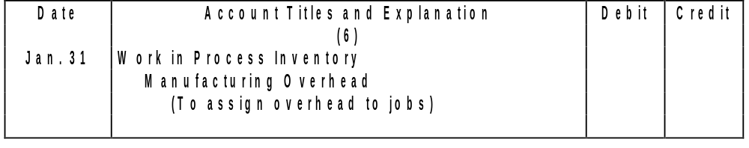
JOB ORDER COST FLOW
At Wallace Products, direct labor cost is the activity base.
Annual overhead costs are expected to be $280,000 and $350,000 of direct labor costs are anticipated.
The overhead rate is 80% ($280,000 ÷ $350,000).
Overhead applied for January is $22,400 ($28,000 X 80%) This application is recorded through the entry below.
22,400
22,400
Notes:
14

Slide 29






USING PREDETERMINED OVERHEAD RATES
Work in Process
is assigned to
and specific jobs
Activity
Base
X
Predetermined Overhead Rate
Job 1
Job 2
Job 3

Slide 30
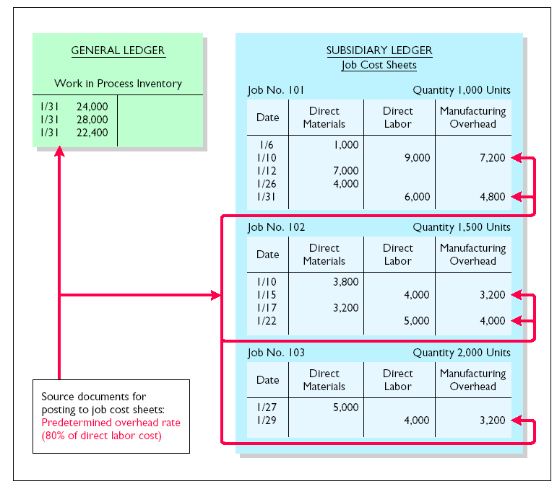
JOB COST SHEETS MANUFACTURING OVERHEAD APPLIED
The debit of $22,400 to Work in Process Inventory equals the sum of the overhead assigned to jobs:
Job 101 $12,000
Job 102 $7,200
Job 103 $3,200.

Slide 31
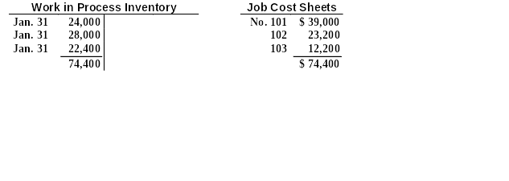
PROOF OF JOB COST SHEETS TO WORK IN PROCESS INVENTORY
At the end of each month, the balance in Work in Process Inventory should equal the sum of the costs shown on the job cost sheets of unfinished jobs.
Assuming that all jobs are unfinished, proof of the agreement of the control and subsidiary accounts in Wallace Products is shown below.
Notes:
15

Slide 32
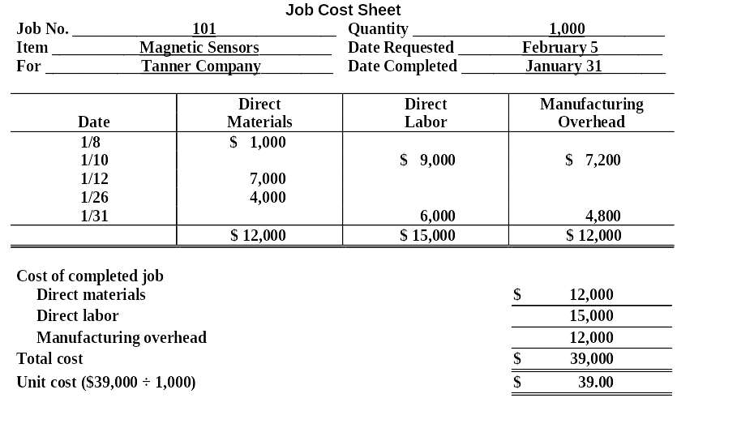
COMPLETED JOB COST SHEET
STUDY OBJECTIVE 5
When a job is completed, the costs are summarized and the lower portion of the applicable job cost sheet is completed.
If Job No. 101 is completed on January 31, the job cost sheet will show the following:

Slide 33
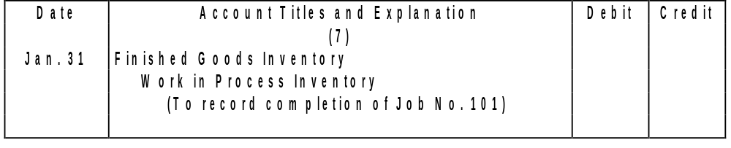
JOB ORDER COST FLOW
When a job is finished, an entry is made to transfer its total cost to Finished Goods Inventory. The entry for Wallace Products on January 31 is:
39,000
39,000

Slide 34
FINISHED GOODS RECORD
Finished Goods Inventory is a control account. It controls individual finished goods records in a finished goods subsidiary ledger.
Postings to the receipts columns are made directly from completed job cost sheets.
The finished goods inventory record for Job No. 101 is shown below.
Item: Magnetic Sensors Job No: 101
Receipts | Issues | Balance
Date | Units | Cost | Total | Units | Cost | Total | Units | Cost | Total
1/31 | 1,000 | $39 | $39,000 |  |  |  | 1,000 | $39 | $39,000

Slide 35
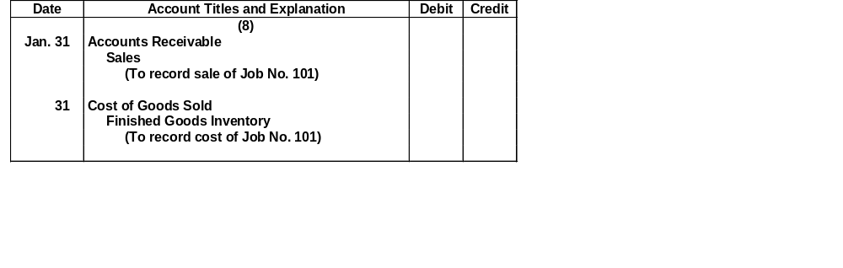
ASSIGNING COSTS TO COST OF GOODS SOLD
Recognition of the cost of goods sold is made when each sale occurs.
On January 31 Wallace Products sells Job No. 101, costing $39,000, for $50,000. The entries are:
50,000
50,000
39,000
39,000

Slide 36
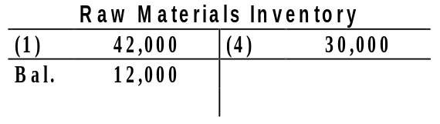
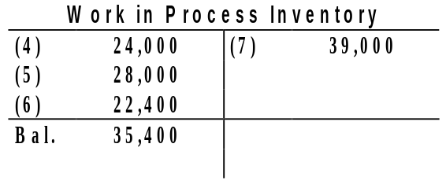
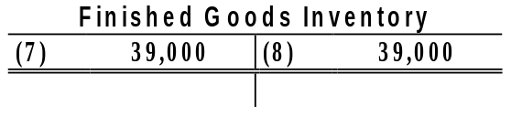
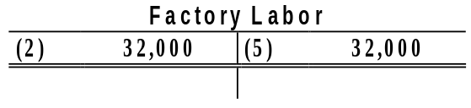
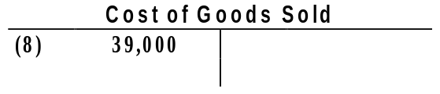
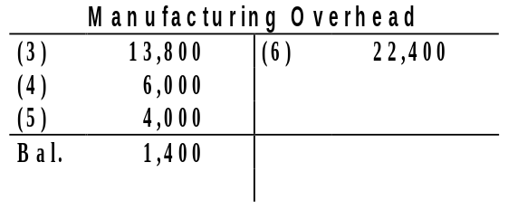
JOB ORDER COST SYSTEM FLOW OF COSTS
Flow of Costs
4
7
8
5
Key to Entries:
6

Slide 37
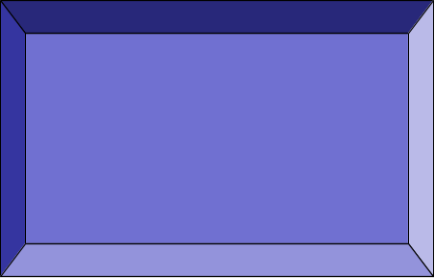
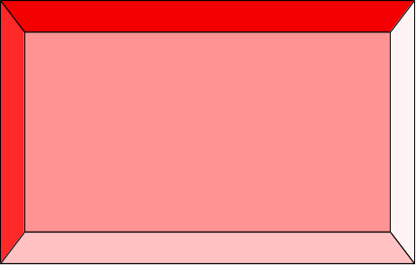
FLOW OF DOCUMENTS IN A
JOB ORDER COST SYSTEM
Flow of Documents
The job cost sheet summarizes the cost of jobs completed and not completed at the end of the accounting period. Jobs completed are transferred to finished goods to await sale.
Materials Requisition Slips
Cost of Jobs is Summarized on a
Jobs Are Charged Through
Labor Time Tickets
Job Cost Sheet
Predetermined Overhead Rate

Slide 38
COST OF GOODS MANUFACTURED SCHEDULE
WALLACE MANUFACTURING COMPANY
Cost of Goods Manufactured Schedule
For
the Month Ended January 31, 2005
Work in process inventory, January 1
$
–
0
–
Direct materials used
$ 24,000
Direct labor
28,000
Manufacturing overhead app
lied
22,400
Total manufacturing costs
74,400
Total cost of work in process
74,400
Less: Work in process inventory, January 31
35,400
Cost of goods manufactured
$ 39,000
The cost of goods manufactured schedule in job order costing is the same as in Chapter 20 with one exception: Manufacturing overhead applied, rather than actual overhead costs, is added to direct materials and direct labor to determine total manufacturing costs. The schedule is prepared directly from the Work in Process Inventory account.

Slide 39
PARTIAL INCOME STATEMENT
WALLACE PRODUCTS INC.
Income Statement
For the Month Ended January 31, 2005
Sales
$ 50,000
Less: Cost of goods sold
Finished goods inventory, January 1
$
–
0
–
Cost of goods manufactured
39,000
Cost of g
oods available for sale
39,000
Finished goods inventory, January 31
–
0
–
Cost of goods sold
39,000
Gross profit
$ 11,000
The cost of goods manufactured ($39,000) agrees with the amount transferred from Work in Process Inventory to Finished Goods Inventory in journal entry No. 7 in Illustration 21-18.

Slide 40
UNDER- OR OVERAPPLIED MANUFACTURING OVERHEAD
STUDY OBJECTIVE 6
Underapplied overhead means that
1) manufacturing overhead has a debit balance.
2) the overhead assigned to work in process is less than the overhead incurred.
Overapplied overhead means that
1) manufacturing overhead has a credit balance.
2) the overhead assigned to work in process is greater than the overhead incurred.

Slide 41
UNDER- OR OVERAPPLIED MANUFACTURING OVERHEAD
The existence of under- or overapplied overhead at the end of a month usually does not require corrective action by management.
Under- or overapplied overhead is on the monthly balance sheet:
1) underapplied overhead is a prepaid expense (current asset).
2) overapplied overhead is unearned revenue (current liability).

Slide 42
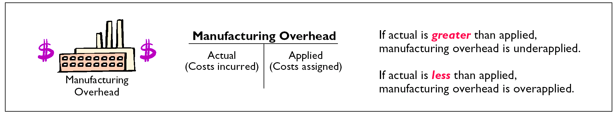
UNDER- OR OVERAPPLIED OVERHEAD

Slide 43
UNDER- OR OVERAPPLIED MANUFACTURING OVERHEAD
Any year-end balance in Manufacturing Overhead is eliminated by an adjusting entry.
Under- or overapplied overhead is usually considered to be an adjustment to cost of goods sold.
Thus, underapplied overhead is debited to Cost of Goods Sold and overapplied overhead is credited to Cost of Goods Sold.
Wallace Products has a $2,500 credit balance in Manufacturing Overhead at December 31. The adjusting entry for the overapplied overhead is shown below.
Date
Account Titles and Explanation
Debit
Credit
Dec. 31
Manufacturing Overhead
2,500
2,500
2,500
Cost of Goods Sold
2,500
(To transfer overapplied overhead to cost
of goods sold)

Slide 44
Work in Process Inventory is debited for all of the following except:
a. raw materials used.
b. manufacturing overhead incurred.
c. manufacturing overhead applied.
d. factory labor used.
Chapter 21

Slide 45
Work in Process Inventory is debited for all of the following except:
a. raw materials used.
b. manufacturing overhead incurred.
c. manufacturing overhead applied.
d. factory labor used.
Chapter 21

Slide 46

JOB ORDER COST ACCOUNTING
Copyright © 2005 John Wiley & Sons, Inc. All rights reserved. Reproduction or translation of this work beyond that named in Section 117 of the United States Copyright Act without the express written consent of the copyright owner is unlawful. Request for further information should be addressed to the Permissions Department, John Wiley & Sons, Inc. The purchaser may make back-up copies for his/her own use only and not for distribution or resale. The Publisher assumes no responsibility for errors, omissions, or damages, caused by the use of these programs or from the use of the information contained herein.
Notes:
34

